Slide 1
Machine Learning

Slide 2
Machine Learning (ML) is a part of Artificial Intelligence (AI) that focuses on creating algorithms and models that allow computers to learn from data.
Instead of writing separate code for every task, we train the computer with data so it can improve its performance through experience.
In simple words, Machine Learning helps computers learn patterns from data and make decisions similar to humans.
There are different types of machine learning, and each type has its own features and uses. The main types of machine learning are:
1. Supervised Machine Learning 2. Unsupervised Machine Learning 3. Reinforcement Learning

Slide 3
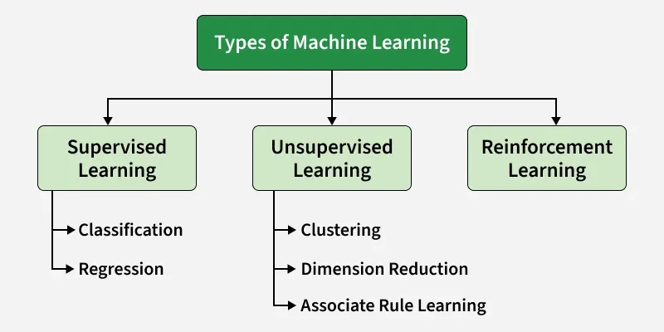

Slide 4
Supervised Machine Learning
Supervised learning is a type of machine learning where the model is trained using a labeled dataset. A labeled dataset means the data includes both input values and their correct output values.
In supervised learning, the algorithm learns the relationship between the input and the correct output. It studies the training data and tries to predict the correct output for new data.
Both the training dataset and the validation dataset contain labeled data, so the model can learn and then be tested for accuracy.

Slide 5
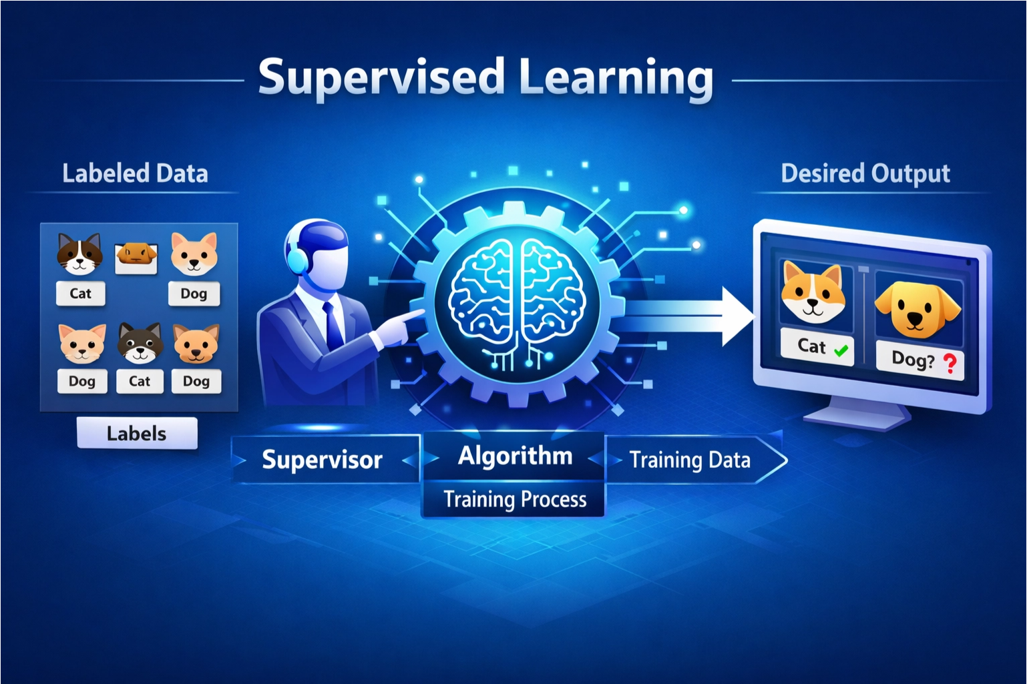
Example: If you train a model using labeled images of cats and dogs, it learns the features of each. When shown a new image, it predicts whether it’s a cat or a dog.

Slide 6
The model makes predictions and compares them with the true outputs, adjusting itself to reduce errors and improve accuracy over time.
The goal is to make accurate predictions on new, unseen data.
For example, a model trained on images of handwritten digits can recognize new digits it has never seen before.

Slide 7
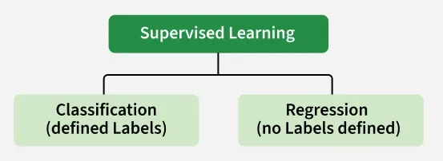
Types of Supervised Learning in Machine Learning
Classification: Where the output is a categorical variable (spam vs. non-spam emails, yes vs. no).
Regression: Where the output is a continuous variable
( predicting house prices, stock prices).

Slide 8
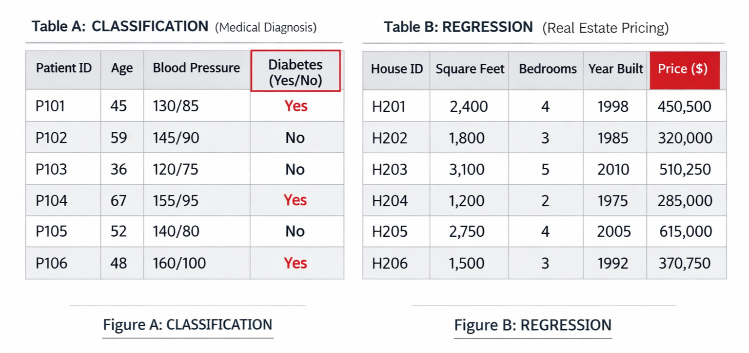
Figure A: CLASSIFICATION (Medical Diagnosis) predicting if a patient has diabetes or not based on age, BP, and cholesterol levels.
Input: Patient ID, Age, Blood Pressure, Cholesterol
Output: Diabetes (Yes/No); 'Yes' means the patient has diabetes, and 'No' means the patient does not have diabetes.
Figure B: REGRESSION (Real Estate Pricing) predicting price of a house based on different parameters.
Input: House ID, Square Feet, Bedrooms, Year Built
Output: Price ($); a continuous numerical value representing the estimated price of the house.

Slide 9
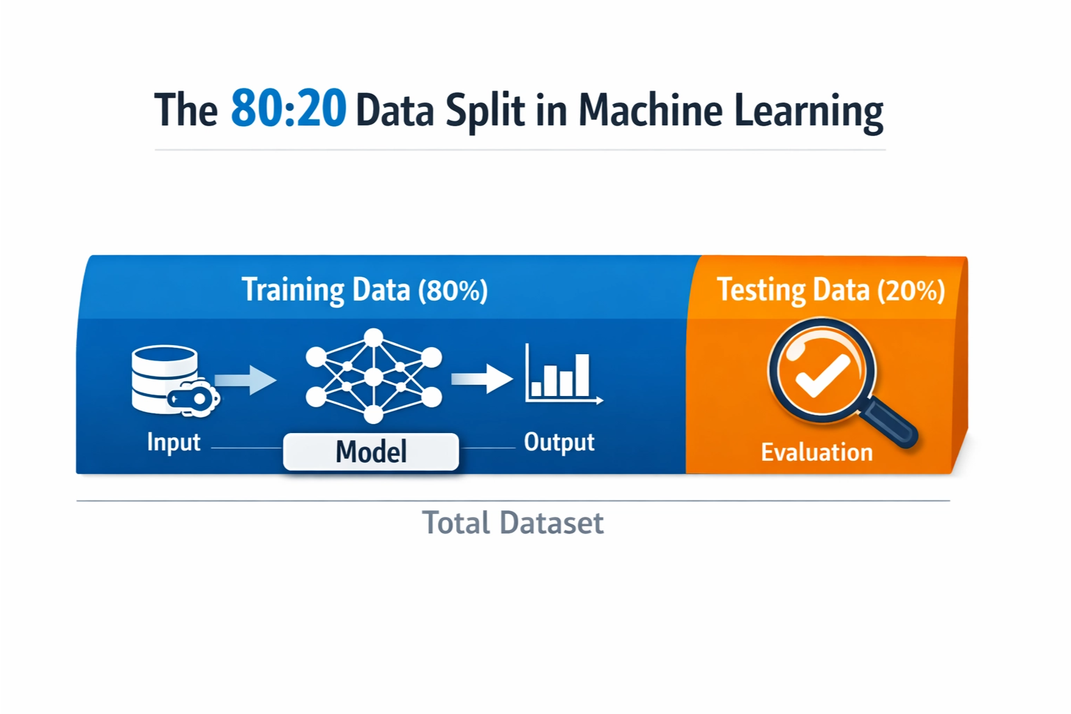

Slide 10
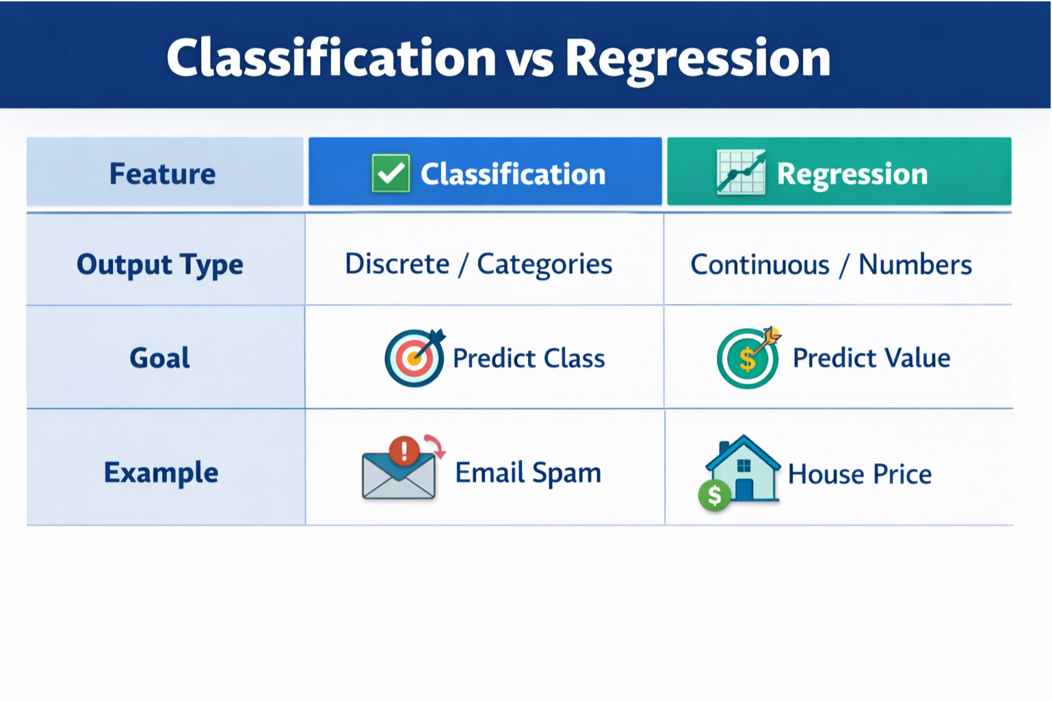

Slide 11
Working of Supervised Machine Learning
1. Collect Labeled Data
Gather a dataset where each input has a known correct output (label).
Example: Images of handwritten digits with their actual numbers as labels.
2. Split the Dataset
Divide the data into training data (about 80%) and testing data (about 20%).
The model will learn.
3. Train the Model
Feed the training data (inputs and their labels) to a suitable supervised learning algorithm (like Decision Trees, SVM or Linear Regression).
4. Validate and Test
Evaluate the model using testing data it has never seen before.
The model predicts outputs and these predictions are compared with the actual labels to calculate accuracy or error.
5. Deploy and Predict on New Data
Once the model performs well, it can be used to predict outputs for completely new, unseen data.

Slide 12
Supervised Machine Learning Algorithms
Linear Regression:- to predict a continuous value. Example: Predicting house price, salary, or temperature. It finds a straight-line relationship between input and output.
Logistic Regression:- for classification, mainly for two possible outcomes. Example: Yes/No, Pass/Fail, Spam/Not Spam.
Decision Tree:- like a flowchart or tree. It makes decisions step by step using conditions. Each branch represents a choice, and each leaf represents the final result. Example: Loan approval based on income, age, and credit score.
Random Forest:- is a group of many decision trees. Each tree gives a prediction, and the final answer is based on the majority vote (for classification) or average (for regression). It is more accurate and stable than a single decision tree.

Slide 13
Support Vector Machine (SVM):- to draw a boundary (line or plane) between different classes. It separates data in the best possible way so that the gap between classes is maximum. The points that help create this boundary are called support vectors.
K-Nearest Neighbors (KNN) KNN looks at the “k” closest data points to make a prediction. For classification, it checks which class is most common among the neighbors. For regression, it takes the average value. Example: If most nearby points are “Blue,” the new point is predicted as “Blue.”
Gradient Boosting:- builds models step by step. Each new model tries to fix the mistakes made by the previous model. By combining many small models, it creates a strong and accurate final model.
Naive Bayes Algorithm:- based on probability. It uses Bayes’ Theorem and assumes that features are independent of each other. It works very well for text classification. Example: Spam email detection.

Slide 14
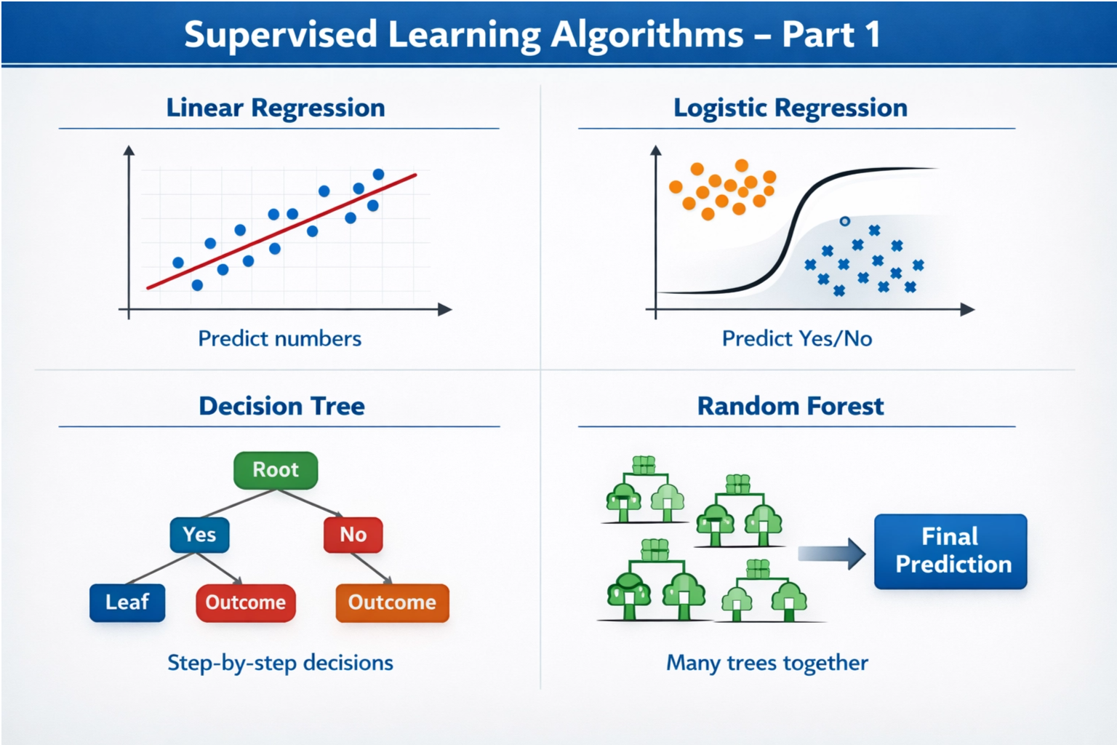

Slide 15
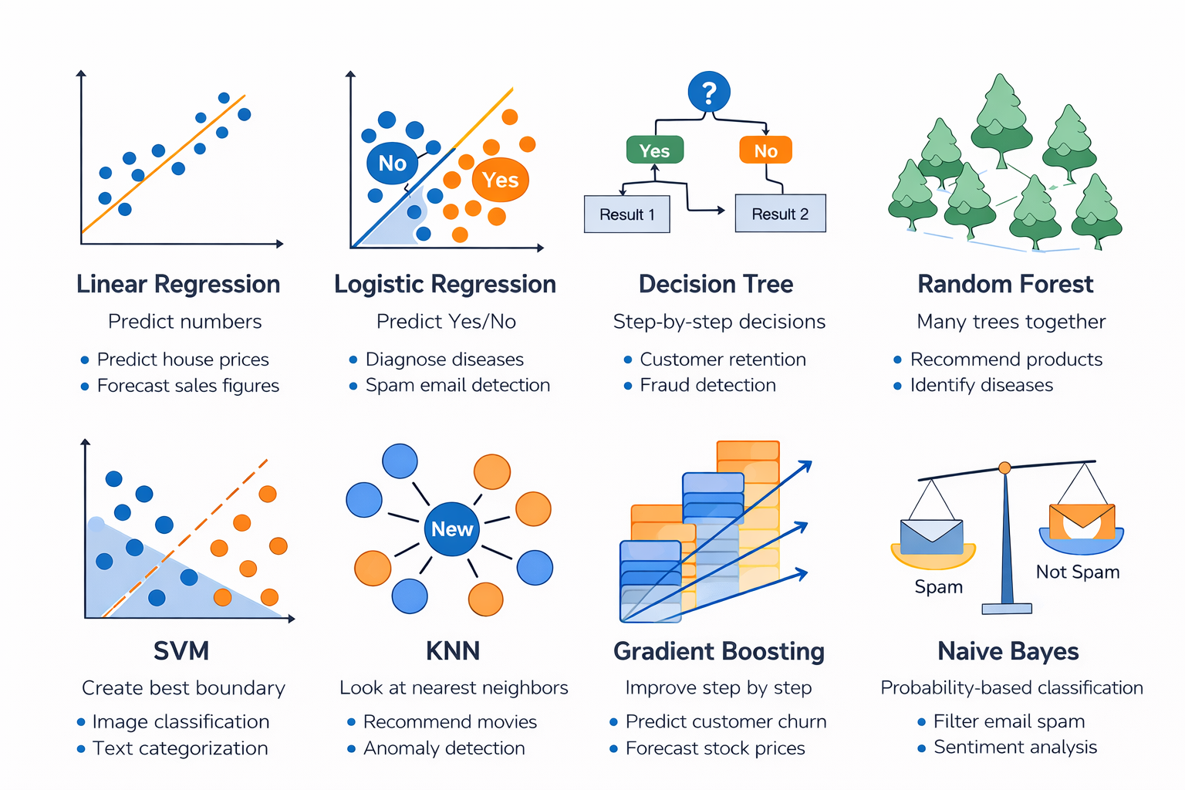

Slide 16
Advantages of Supervised Learning
Easy to understand and implement because it learns from labeled examples. High accuracy when enough labeled data is available.
Works for both classification (spam detection, disease prediction) and regression (price prediction).
Can generalize well to new data if trained properly. Widely used in speech recognition, medical diagnosis, sentiment analysis, fraud detection, and more.

Slide 17
Disadvantages of Supervised Learning
Needs large labeled datasets, which are costly and time-consuming to create.
Can learn bias if the training data is unbalanced.
Risk of overfitting, especially with small datasets. Performance drops if new data is very different from training data.
Not practical for problems with millions of possible labels.

Slide 18
Linear Regression in Machine Learning?
Linear Regression is a supervised learning algorithm that is used to model the relationship between a dependent variable and an independent variable.
The algorithm finds the best fit straight line relationship (linear equation) between the two variables. This statistical method is then used to predict the outcome of future events and is quite useful for predictive analysis.

Slide 19
Suppose you want to determine the salary of a person based on the number of years of work experience they have. What is usually seen is as the number of years of experience increases, their salary increases.
Here years of experience is the independent variable. It’s a parameter that can be controlled.
The Salary of the person is the dependent variable as its value depends on the years of work experience a person has.

Slide 20
What makes Linear Regression so Important?
This algorithm acts as a starting point for machine learning enthusiasts, making it quite simple to understand data.
It helps in predictive analysis proving useful in many industries including marketing, finance, and even healthcare.
It is the base for many advanced algorithms like logistic regression or neural networks.
It the most widely used statistical technique for regression tasks.
The technique offers great performance in tasks for which the relationship between the variables is roughly linear.

Slide 21
Simple Linear Regression
In a simple linear regression, there is one independent variable and one dependent variable.
The model estimates the slope and intercept of the line of best fit, which represents the relationship between the variables

Slide 22
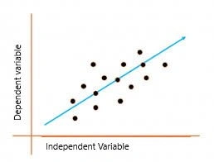
Linear regression is a quiet and the simplest statistical regression technique used for predictive analysis in machine learning.
It shows the linear relationship between the independent(predictor) variable i.e. X-axis and the dependent (output) variable i.e. Y-axis, called linear regression.
If there is a single input variable X (independent variable), such linear regression is simple linear regression.

Slide 23
Example
# ===============================================
# SIMPLE LINEAR REGRESSION WITH TKINTER GUI
# ===============================================
import pandas as pd
import numpy as np
from sklearn.linear_model import LinearRegression
import tkinter as tk
from tkinter import messagebox
# Step 1: Create Dataset
data = {
"Size_sqft": [500, 800, 1000, 1200, 1500, 1800, 2000, 2200, 2500, 3000],
"Price": [1000000, 1500000, 1800000, 2200000, 2700000,
3200000, 3600000, 4000000, 4500000, 5500000]
}
df = pd.DataFrame(data)
X = df[["Size_sqft"]]
y = df["Price"]
# Step 2: Train Model
model = LinearRegression()
model.fit(X, y)
# Step 3: Tkinter UI
root = tk.Tk()
root.title("Simple House Price Predictor")
tk.Label(root, text="Enter House Size (sqft):").pack()
size_entry = tk.Entry(root)
size_entry.pack()
def predict():
try:
size = float(size_entry.get())
prediction = model.predict([[size]])
messagebox.showinfo("Prediction",
f"Estimated Price: ₹ {round(prediction[0],2)}")
except:
messagebox.showerror("Error", "Please enter valid number")
tk.Button(root, text="Predict Price", command=predict).pack()
root.mainloop()

Slide 24
Multiple Linear Regression (MLR)?
basically indicating that we will have many features Such as f1, f2, f3, f4, and our output feature f5.
suppose:
f1 is the size of the house,
f2 is bad rooms in the house,
f3 is the locality of the house,
f4 is the condition of the house, and
f5 is our output feature, which is the price of the house.

Slide 25
“If we have one dependent feature and multiple independent features then basically call it a multiple linear regression.”
Multiple linear regression analyzes the relationship between independent variables and a dependent variable.
It’s an extension of simple linear regression, which deals with only one independent variable.
Here’s an example of how to use multiple linear regression in Python with the popular library, scikit-learn

Slide 26
# Import necessary libraries
import pandas as pd
from sklearn.model_selection import train_test_split
from sklearn.linear_model import LinearRegression
from sklearn import metrics
import numpy as np # Added for RMSE calculation
# Generate a sample dataset
data = {'X1': [1, 2, 3, 4, 5],
'X2': [2, 3, 4, 5, 6],
'Y': [3, 5, 7, 9, 11]}
df = pd.DataFrame(data)
# Independent and dependent variables
X = df[['X1', 'X2']]
Y = df['Y']
# Train-test split
X_train, X_test, Y_train, Y_test = train_test_split(
X, Y, test_size=0.2, random_state=42
)
# Create model
model = LinearRegression()
# Train model
model.fit(X_train, Y_train)
# Predictions
Y_pred = model.predict(X_test)
# Evaluation
mae = metrics.mean_absolute_error(Y_test, Y_pred)
mse = metrics.mean_squared_error(Y_test, Y_pred)
rmse = np.sqrt(mse) # Correct way to calculate RMSE
print('Mean Absolute Error:', mae)
print('Mean Squared Error:', mse)
print('Root Mean Squared Error:', rmse)
(Intercept: The starting value of the output when the input is 0. Coefficient: The value that shows how much the output changes when the input increases by 1.)
# Coefficients
print('Coefficients:', model.coef_)
print('Intercept:', model.intercept_)

Slide 27
# =====================================================
# MULTIPLE LINEAR REGRESSION WITH TKINTER GUI
# =====================================================
import pandas as pd
import numpy as np
from sklearn.linear_model import LinearRegression
from sklearn.preprocessing import LabelEncoder
import tkinter as tk
from tkinter import messagebox
# Step 1: Create Dataset
data = {
"Size_sqft": [800, 1000, 1200, 1500, 1800, 2000, 2200, 2500, 3000, 3500],
"Bedrooms": [2, 2, 3, 3, 3, 4, 4, 4, 5, 5],
"Location": ["A", "A", "B", "B", "C", "C", "B", "A", "C", "B"],
"Age_of_House": [10, 8, 5, 7, 3, 2, 4, 6, 1, 2],
"Price": [3000000, 3500000, 4000000, 5000000, 6500000,
7500000, 7000000, 6000000, 9000000, 8500000]
}
df = pd.DataFrame(data)
# Encode Location
le = LabelEncoder()
df["Location"] = le.fit_transform(df["Location"])
X = df.drop("Price", axis=1)
y = df["Price"]
# Train Model
model = LinearRegression()
model.fit(X, y)
# Tkinter UI
root = tk.Tk()
root.title("Advanced House Price Predictor")
tk.Label(root, text="Size (sqft):").pack()
size_entry = tk.Entry(root)
size_entry.pack()
tk.Label(root, text="Bedrooms:").pack()
bedroom_entry = tk.Entry(root)
bedroom_entry.pack()
tk.Label(root, text="Location (A/B/C):").pack()
location_entry = tk.Entry(root)
location_entry.pack()
tk.Label(root, text="Age of House:").pack()
age_entry = tk.Entry(root)
age_entry.pack()
def predict():
try:
size = float(size_entry.get())
bedrooms = int(bedroom_entry.get())
location = le.transform([location_entry.get()])[0]
age = float(age_entry.get())
input_data = [[size, bedrooms, location, age]]
prediction = model.predict(input_data)
messagebox.showinfo("Prediction",
f"Estimated Price: ₹ {round(prediction[0],2)}")
except:
messagebox.showerror("Error", "Check your input values!")
tk.Button(root, text="Predict Price", command=predict).pack()
root.mainloop()

Slide 28
Logistic Regression
Logistic Regression is a classification algorithm used to predict categories like Yes/No or 0/1.
It calculates the probability that an input belongs to a particular class.
It uses a Sigmoid function to convert values into a range between 0 and 1.
If the probability is greater than 0.5, it predicts class 1; otherwise class 0.
It is mainly used for problems like spam detection, disease prediction, and customer churn prediction.

Slide 29
# Import libraries
import numpy as np
from sklearn.linear_model import LogisticRegression
# Sample data (Hours studied vs Pass/Fail)
X = np.array([[1], [2], [3], [4], [5]]) # Hours studied
y = np.array([0, 0, 0, 1, 1]) # 0 = Fail, 1 = Pass
# Create model
model = LogisticRegression()
# Train model
model.fit(X, y)
# Predict for 3.5 hours study
prediction = model.predict([[3.5]])
probability = model.predict_proba([[3.5]])
print("Prediction (0=Fail, 1=Pass):", prediction)
print("Probability:", probability)

Slide 30
Explanation in Simple Words:
We give study hours as input.
Model learns who passed and failed.
When we give 3.5 hours, it predicts whether the student will pass or fail.
predict() gives class (0 or 1).
predict_proba() gives probability of both classes.
Sigmoid Function
The Sigmoid function is a mathematical function used in Logistic Regression.
It converts any number into a value between 0 and 1.
It is used to calculate probability.
If output is close to 1 → Yes / True / Class 1.
If output is close to 0 → No / False / Class 0.

Slide 31
There are 3 main types of Logistic Regression based on the type of output.
Binary Logistic Regression
Used when output has only 2 classes. Example:
Pass / Fail
Spam / Not Spam
Yes / No
Multinomial Logistic Regression
Used when output has more than 2 classes (no order). Example:
Red / Blue / Green
Cat / Dog / Cow
Class A / B / C
Ordinal Logistic Regression
Used when output has ordered categories. Example:
Low / Medium / High
Rating 1 to 5
Poor / Average / Good / Excellent

Slide 32
Decision Tree
A Decision Tree is a supervised machine learning algorithm used for classification and regression.
It works like a flowchart (tree structure).
It asks a series of if-else questions to make decisions.
Each internal node = condition (question).
Each branch = answer (Yes/No).
Final node (leaf) = prediction result.

Slide 33
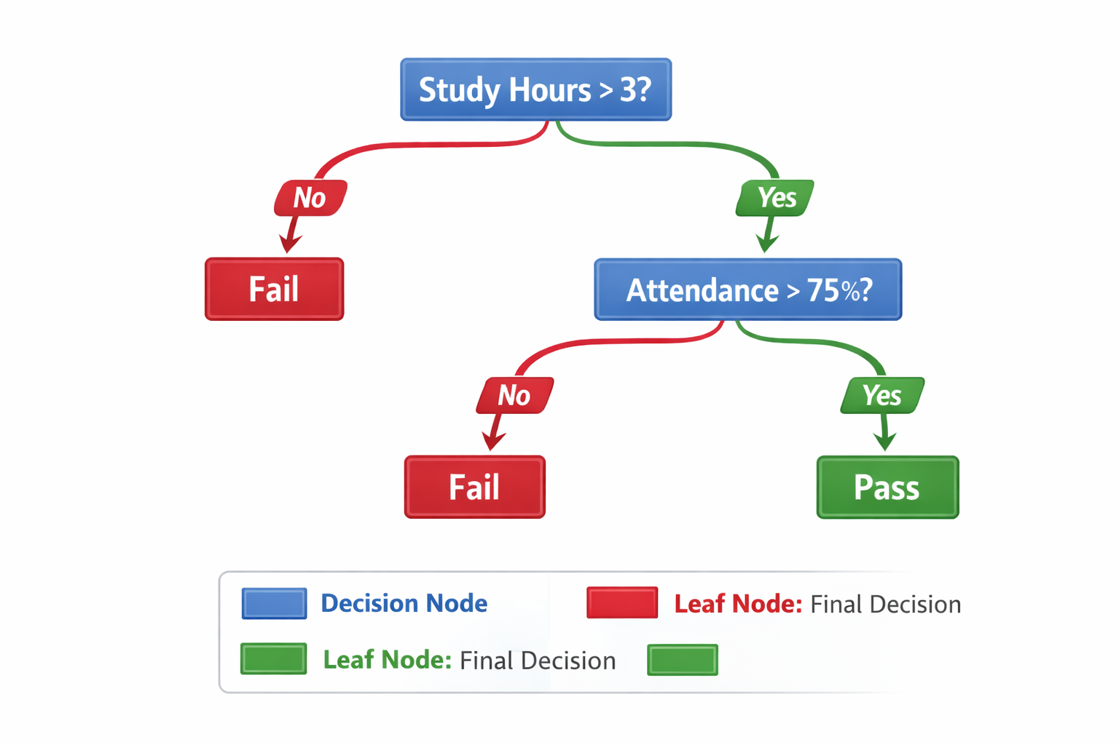

Slide 34
Types of Decision Tree
1. Classification Tree
Used when output is categorical (class)
Example: Spam/Not Spam, Pass/Fail
2. Regression Tree
Used when output is numerical (continuous)
Example: Salary, House Price
Uses: Mean Squared Error (MSE)

Slide 35
Classification Example
from sklearn.tree import DecisionTreeClassifier
import numpy as np
# Sample data (Hours studied)
X = np.array([[1], [2], [3], [4], [5]])
y = np.array([0, 0, 0, 1, 1]) # 0 = Fail, 1 = Pass
# Create model
model = DecisionTreeClassifier()
# Train model
model.fit(X, y)
# Predict
prediction = model.predict([[3.5]])
print("Prediction (0=Fail, 1=Pass):", prediction)

Slide 36
Regression Example
from sklearn.tree import DecisionTreeRegressor
import numpy as np
# Sample data
X = np.array([[1], [2], [3], [4], [5]])
y = np.array([10000, 20000, 30000, 40000, 50000]) # Salary
# Create model
model = DecisionTreeRegressor()
# Train model
model.fit(X, y)
# Predict
prediction = model.predict([[3.5]])
print("Predicted Salary:", prediction)

Slide 37
Random Forest
Random Forest is an advanced machine learning algorithm based on Decision Trees.
It builds many decision trees instead of just one.
Each tree is trained on random data samples.
Each tree gives a prediction.
Final prediction is based on majority voting (classification) or average (regression).
It reduces overfitting and improves accuracy.

Slide 38
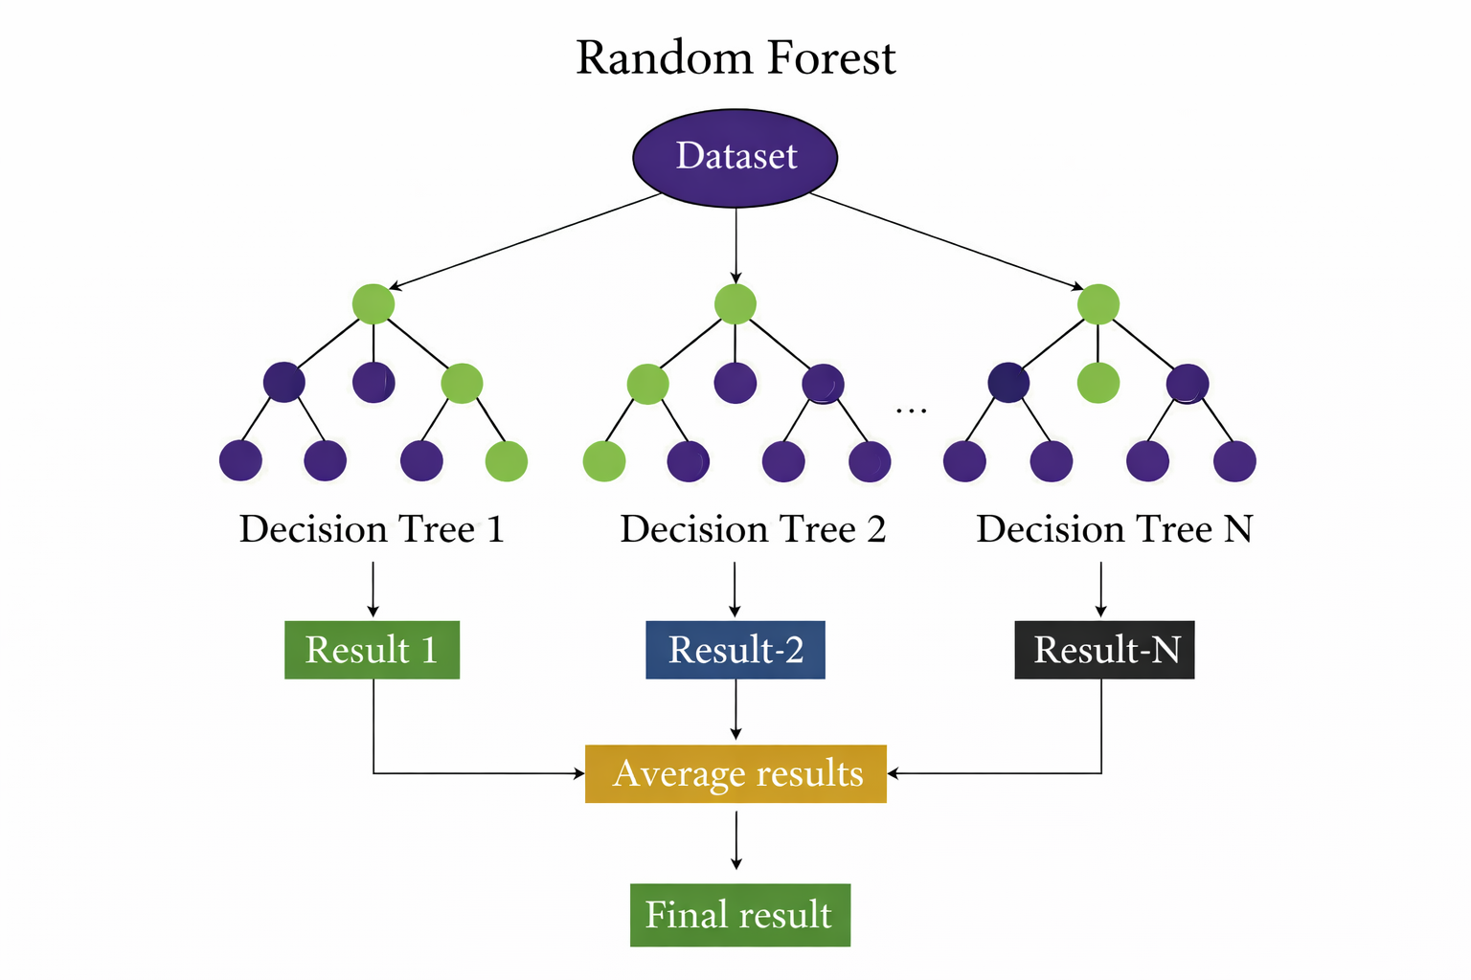

Slide 39
Types of Random Forest
1. Random Forest for Classification
Output = Categories (Yes/No, Spam/Not Spam)
Final result = Majority Voting
2. Random Forest for Regression
Output = Continuous value (Salary, Price)
Final result = Average of all outputs

Slide 40
Regression Example
from sklearn.ensemble import RandomForestRegressor
import numpy as np
# Sample data
X = np.array([[1], [2], [3], [4], [5]])
y = np.array([10000, 20000, 30000, 40000, 50000]) # Salary
# Create model
model = RandomForestRegressor(n_estimators=10)
# Train model
model.fit(X, y)
# Predict
prediction = model.predict([[3.5]])
print("Predicted Salary:", prediction)

Slide 41
Classification Example
from sklearn.ensemble import RandomForestClassifier
import numpy as np
# Sample data
X = np.array([[1], [2], [3], [4], [5]])
y = np.array([0, 0, 0, 1, 1]) # 0 = Fail, 1 = Pass
# Create model
model = RandomForestClassifier(n_estimators=10)
# Train model
model.fit(X, y)
# Predict
prediction = model.predict([[3.5]])
print("Prediction (0=Fail, 1=Pass):", prediction)

Slide 42
Support Vector Machine (SVM)
Support Vector Machine (SVM) is a supervised machine learning algorithm used for classification and regression.
It tries to find the best line (or boundary) to separate data into classes.
This boundary is called a Hyperplane.
It chooses the hyperplane with the maximum margin (maximum distance from nearest points).
The nearest data points are called Support Vectors.
It works well for both linear and non-linear data.

Slide 43
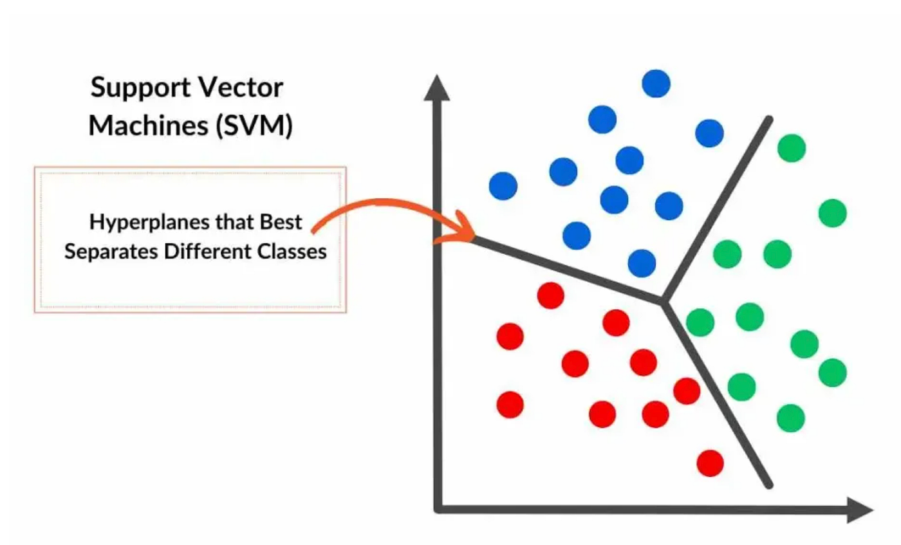
Key Terms:
Hyperplane → Decision boundary (line in 2D)
Margin → Distance between boundary and nearest points
Support Vectors → Points closest to boundary

Slide 44
Classification Example
from sklearn.svm import SVC
import numpy as np
# Sample data (Hours studied)
X = np.array([[1], [2], [3], [4], [5]])
y = np.array([0, 0, 0, 1, 1]) # 0 = Fail, 1 = Pass
# Create model
model = SVC(kernel='linear')
# Train model
model.fit(X, y)
# Predict
prediction = model.predict([[3.5]])
print("Prediction (0=Fail, 1=Pass):", prediction)

Slide 45
Regression Example (SVR)
from sklearn.svm import SVR
import numpy as np
# Sample data
X = np.array([[1], [2], [3], [4], [5]])
y = np.array([10000, 20000, 30000, 40000, 50000])
# Create model
model = SVR(kernel='linear')
# Train model
model.fit(X, y)
# Predict
prediction = model.predict([[3.5]])
print("Predicted Value:", prediction)

Slide 46
K-Nearest Neighbors (KNN)
KNN is a supervised learning algorithm used for classification and regression.
It does not build a model; it stores all training data.
When new data comes, it finds the K nearest data points.
For classification → it uses majority voting.
For regression → it uses the average of nearest values.

Slide 47
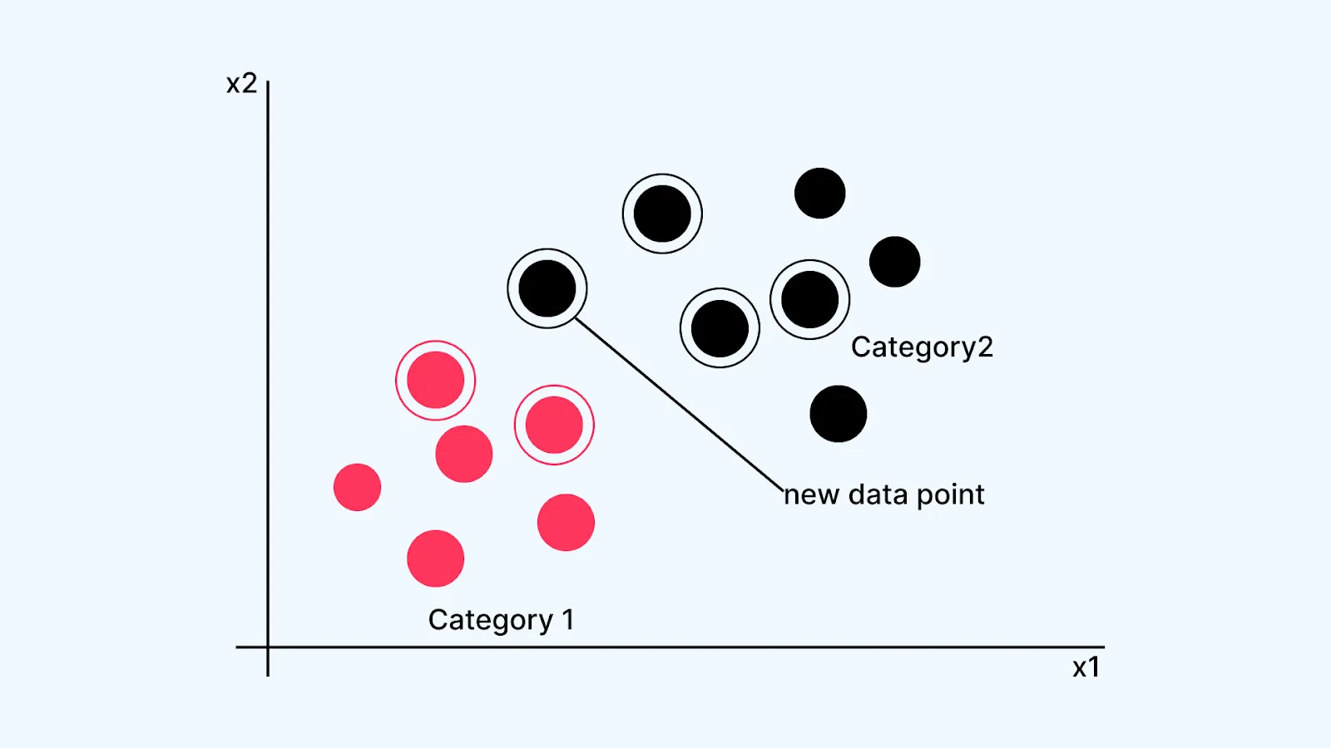

Slide 48
Red Points → Category 1
Black Points → Category 2
Circled Points → Nearest Neighbors
Arrow → New Data Point
What Is Happening in the Diagram?
A new data point appears.
The algorithm calculates distance from this point to all training points.
It selects the K nearest neighbors (white circled points).
In your diagram:
Most of the circled nearest neighbors belong to Category 2 (black).
So using:
Majority voting → the new data point will be classified as Category 2.
Decision happens at prediction time.

Slide 49
Types of KNN
1️. KNN Classification
Output = Category (0/1, Yes/No)
Uses majority voting
2️. KNN Regression
Output = Continuous number
Uses average
Important Concept: Value of K
Small K → Overfitting
Large K → Underfitting
Usually choose odd number (3, 5, 7)

Slide 50
Classification
from sklearn.neighbors import KNeighborsClassifier
import numpy as np
# Sample Data
X = np.array([[1], [2], [3], [4], [5]])
y = np.array([0, 0, 0, 1, 1])
model = KNeighborsClassifier(n_neighbors=3)
model.fit(X, y)
prediction = model.predict([[3.5]])
print("Prediction:", prediction)

Slide 51
Regression
from sklearn.neighbors import KNeighborsRegressor
import numpy as np
X = np.array([[1], [2], [3], [4], [5]])
y = np.array([10000, 20000, 30000, 40000, 50000])
model = KNeighborsRegressor(n_neighbors=3)
model.fit(X, y)
prediction = model.predict([[3.5]])
print("Predicted Value:", prediction)

Slide 52
Gradient Boosting
Gradient Boosting is an ensemble learning algorithm.
It builds many small decision trees sequentially.
Each new tree tries to correct the errors of the previous tree.
It improves model performance step by step.
It gives very high accuracy but may take more time to train.

Slide 53
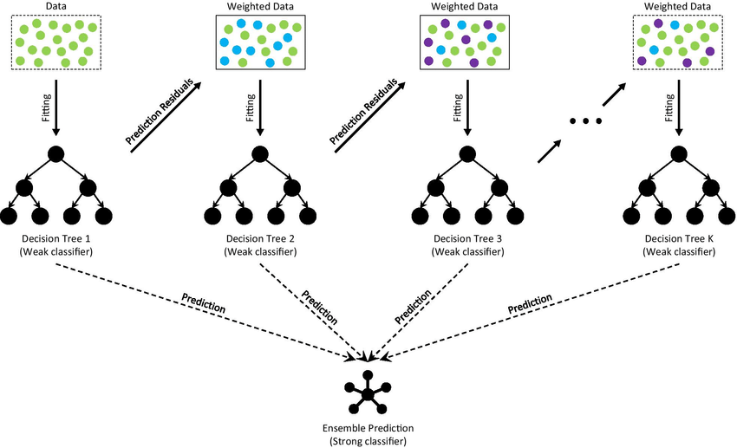

Slide 54
Types of Gradient Boosting
1. Gradient Boosting Classifier
Used for classification (Yes/No, Spam/Not Spam)
2️. Gradient Boosting Regressor
Used for regression (Price, Salary)

Slide 55
Classification Example
from sklearn.ensemble import GradientBoostingClassifier
import numpy as np
# Sample Data
X = np.array([[1], [2], [3], [4], [5]])
y = np.array([0, 0, 0, 1, 1])
model = GradientBoostingClassifier()
model.fit(X, y)
prediction = model.predict([[3.5]])
print("Prediction:", prediction)

Slide 56
Regression Example
from sklearn.ensemble import GradientBoostingRegressor
import numpy as np
X = np.array([[1], [2], [3], [4], [5]])
y = np.array([10000, 20000, 30000, 40000, 50000])
model = GradientBoostingRegressor()
model.fit(X, y)
prediction = model.predict([[3.5]])
print("Predicted Value:", prediction)

Slide 57
Naive Bayes
Naive Bayes is a supervised machine learning algorithm mainly used for classification.
It is based on Bayes’ Theorem from probability.
It assumes that all features are independent (this is the “naive” assumption).
It calculates the probability of each class.
The class with the highest probability is selected as prediction.

Slide 58
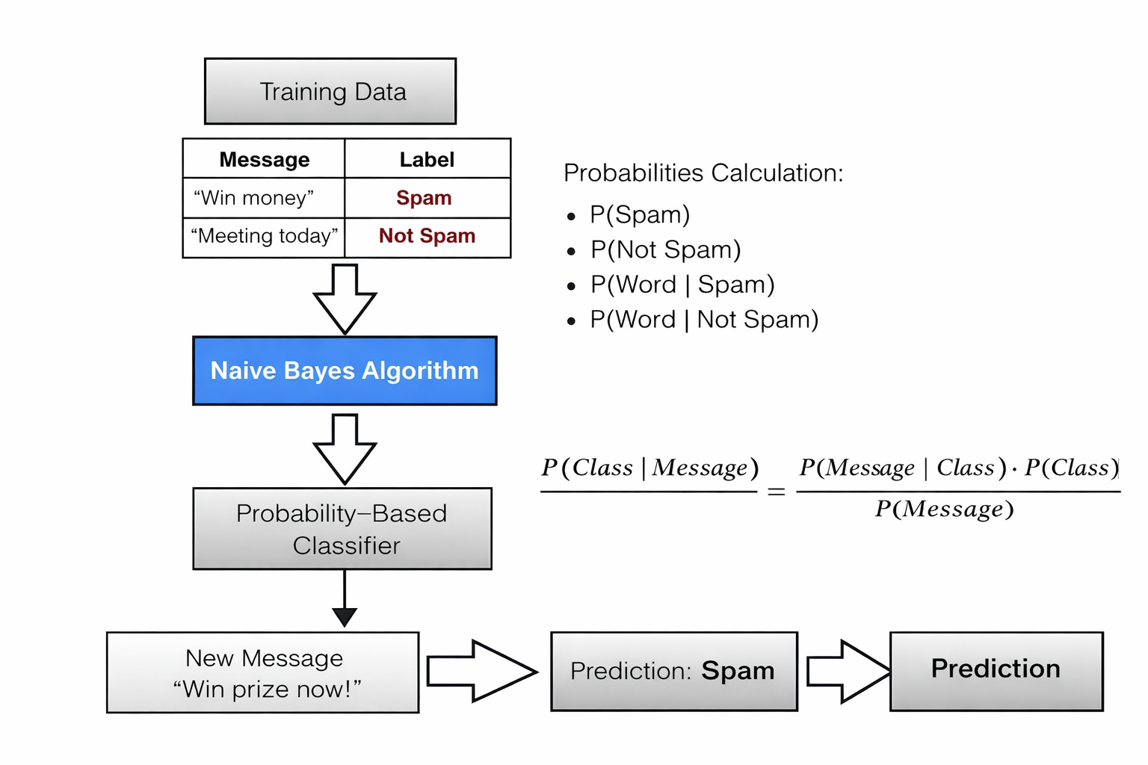

Slide 59
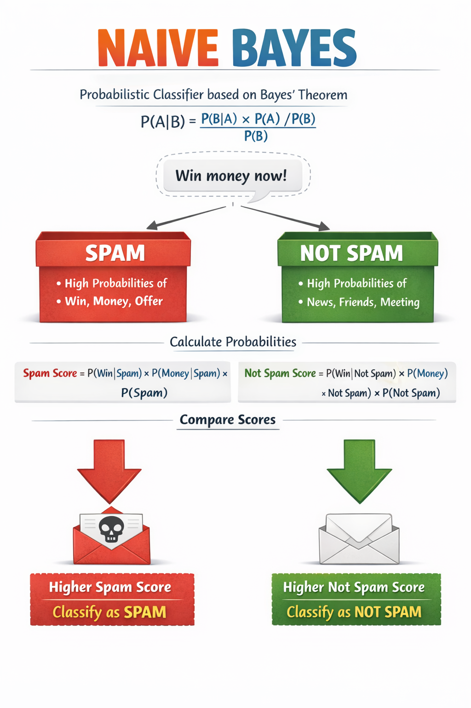

Slide 60
Types of Naive Bayes
1️. Gaussian Naive Bayes
Used for continuous data
Assumes normal distribution
2️. Multinomial Naive Bayes
Used for text classification
Works with word counts
3️. Bernoulli Naive Bayes
Used for binary features (0/1)

Slide 61
Classification Example
from sklearn.naive_bayes import GaussianNB
import numpy as np
# Sample Data
X = np.array([[1], [2], [3], [4], [5]])
y = np.array([0, 0, 0, 1, 1])
model = GaussianNB()
model.fit(X, y)
prediction = model.predict([[3.5]])
print("Prediction:", prediction)

Slide 62
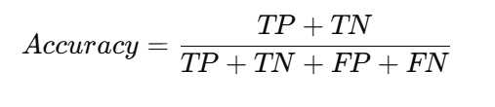
Model Evaluation Metrics
1. Accuracy
Definition: Accuracy measures how many predictions made by the model are correct out of all predictions.
Formula:
Explanation: It calculates the percentage of correctly predicted instances.
Example: If a model predicts 90 correct results out of 100, then: Accuracy = 90 / 100 = 0.90 (90%)

Slide 63
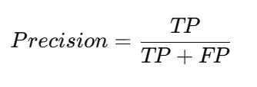
2. Precision
Definition: Precision measures how many of the predicted positive cases are actually positive.
Formula:
Explanation: It tells how reliable the positive predictions of the model are.
Example: If a model predicts 50 positive cases and 40 are actually positive, then: Precision = 40 / 50 = 0.80 (80%)

Slide 64

3. Recall (Sensitivity)
Definition: Recall measures how many actual positive cases were correctly predicted by the model.
Formula:
Explanation: It shows the model’s ability to detect all positive instances.
Example: If there are 60 actual positive cases and the model detects 45, then: Recall = 45 / 60 = 0.75 (75%)

Slide 65
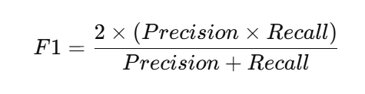
4. F1-Score
Definition: F1-score is the harmonic mean of Precision and Recall.
Formula:
Explanation: It balances Precision and Recall, especially useful when the dataset is imbalanced.
Example: If Precision = 0.80 Recall = 0.75
F1 Score = 0.77

Slide 66
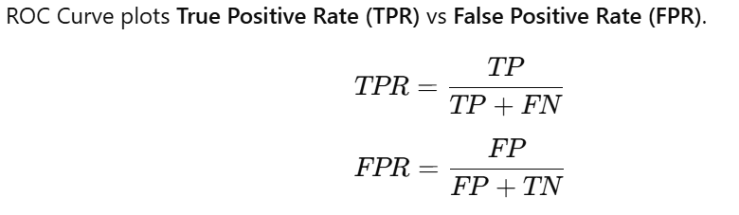
5. ROC AUC
Definition: ROC AUC measures the model's ability to distinguish between classes.
Formula:
Explanation: AUC (Area Under Curve) represents how well the model separates positive and negative classes.
Example:
AUC = 1.0 → Perfect model
AUC = 0.5 → Random model

